Slide 1
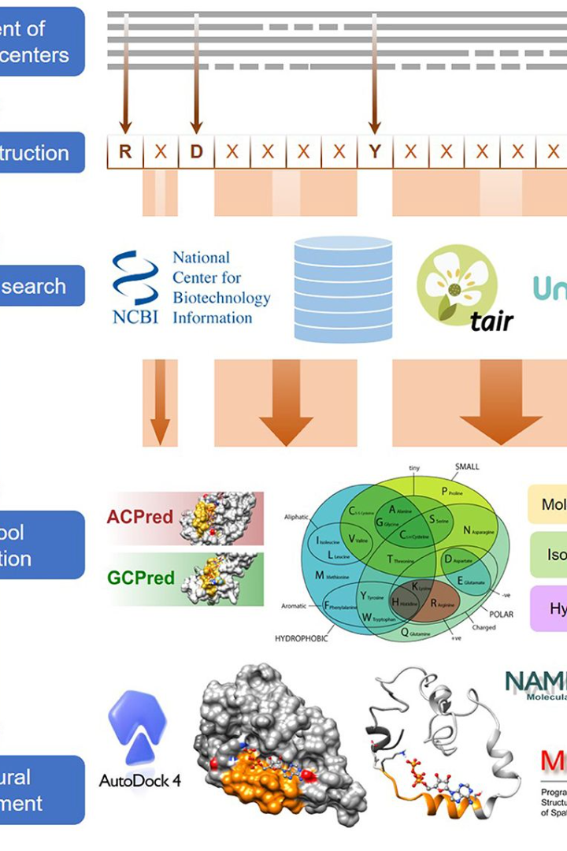
Bioinformatics Tools Overview
Here's a concise overview of essential bioinformatics tools and their installation commands for Linux, essential for sequence analysis, alignment, and phylogenetic tree inference.

Slide 2

NCBI-BLAST+
Introduction
Use
NCBI-BLAST+ is a suite of tools for sequence similarity searching, crucial for identifying homologous sequences.
It is used to search for sequences in nucleotide or protein databases to find similar sequences, aiding in functional prediction.
Installing Command (Linux)
sudo apt-get install ncbi-blast+

Slide 3

HMMER
Introduction
Use
HMMER is used for searching sequence databases for homologs of protein sequences, enabling protein family identification.
It is commonly used for profile hidden Markov model (HMM) searches, essential for functional annotation.
Installing Command (Linux)
sudo apt-get install hmmer

Slide 4
Jalview
Introduction
Use
Installing Command (Linux)
Jalview is a multiple sequence alignment editor and analysis tool, providing a versatile platform for sequence visualization.
It is used for visualizing and analyzing multiple sequence alignments, aiding in comparative genomics and evolutionary analysis.
sudo apt-get install jalview

Slide 5
Abyss
Introduction
Use
Abyss is a de novo assembly software for short reads, instrumental in genome and transcriptome assembly.
It is used to assemble short reads into longer contigs or scaffolds without a reference genome, critical for species without complete genome information.
Installing Command (Linux)
sudo apt-get install abyss

Slide 6
Jmol
1
Introduction
2
Use
Jmol is a molecular viewer and editor, offering interactive 3D representations of biomolecular structures.
It is used for visualizing and analyzing molecular structures at an atomic level, facilitating protein modeling and structural validation.

Slide 7
Sequence Alignment
MAFFT
MUSCLE
MAFFT is a versatile multiple sequence alignment program, known for its high accuracy and efficiency.
MUSCLE is a robust multiple sequence alignment tool, widely used for large-scale sequence analysis.
sudo apt-get install mafft
sudo apt-get install muscle

Slide 8
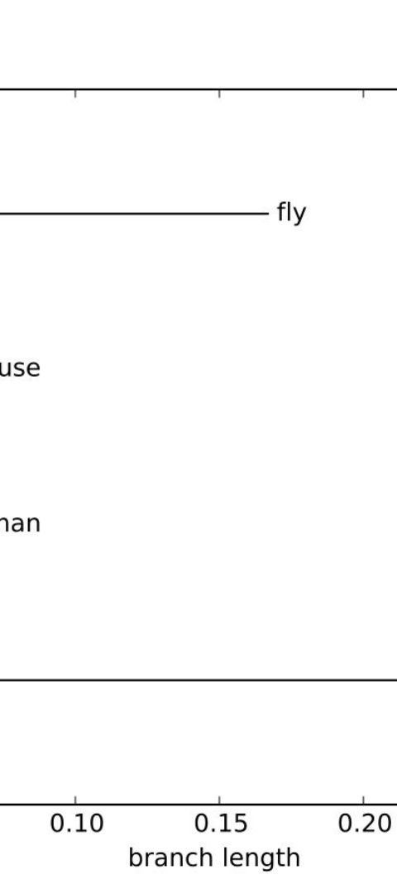
CLUSTAL OMEGA
Introduction
Use
CLUSTAL OMEGA is a state-of-the-art multiple sequence alignment program, designed for high-accuracy alignment.
It is used for the accurate alignment of multiple sequences, ensuring reliable evolutionary and functional analysis.
Installing Command (Linux)
sudo apt-get install clustalo

Slide 9
Phylogenetic Inference
1
Mrbayes
Bayesian inference for phylogeny reconstruction.
sudo apt-get install mrbayes
2
Njplot
Visualization of phylogenetic trees in various formats.
sudo apt-get install njplot
3
Phylip and Phyml
Phylogenetic analysis tools for tree reconstruction and maximum likelihood estimation.
sudo apt-get install phylip
sudo apt-get install phyml

Slide 10


Structure Visualization
Pymol
Jmol
Data visualization and analysis for molecular structures.
Interactive 3D representation for biomolecular structures.
sudo apt-get install pymol
sudo apt-get install jmol

